Slide 1

Lesson01
Advantages of setting up an app

Slide 2
Introduction to design sprint
Advantages of setting up an app
Steps to design app
Introduction and grouping of topics at
the end of the course
http://fpt.edu.vn

Slide 3
Introduction to design sprint
Use design sprints to answer questions, define product directions, figure out cross-team strategies, and even build team culture.
Design sprints generally include five phases: understand, ideate, decide, prototype, and test. We'll come back to these phases and investigate each one later.
Before launching into a design sprint, you need to review your design challenge and ask yourself these key questions:
  Are there many potential solutions to your design challenge?
  Does a design challenge require people from cross-functional teams to weigh in?
  Is the design challenge's scope wide enough for a sprint?
http://fpt.edu.vn

Slide 4
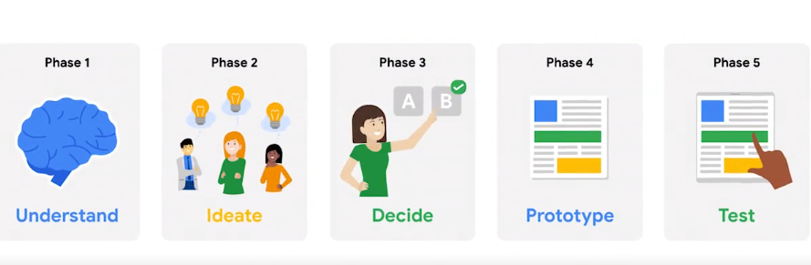
Five phases of design sprint
Understand: The team works to clearly define the design challenge by learning from experts, gathering insights, and engaging in discussions. The focus is on understanding the user's needs and goals.
Ideate: The team brainstorms and generates creative ideas to solve the design challenge. Everyone sketches and presents their ideas, and the team begins to plan for user testing in the next phase.
Decide: The team evaluates all the potential solutions and selects the one that is most likely to meet user needs and achieve the desired outcome.
Prototype: The team creates a realistic, functional prototype based on the chosen solution. The prototype is focused on what the user experiences and doesn't need to be a final product.
Test: The prototype is tested by real users, and their feedback is gathered. The team uses the insights from user testing to identify necessary changes before launching the product.
http://fpt.edu.vn

Slide 5
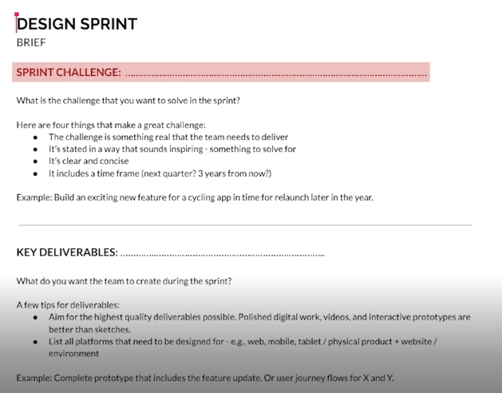
The design sprint brief
Here's a summary of the key elements of a design sprint brief:
Design Sprint Challenge: Introduces the sprint objectives and defines the problem to solve, such as building exciting new features for an app.
Key Deliverables: Outlines what the team aims to achieve by the end of the sprint, like having a complete prototype ready for the new feature.
Logistics: Details where and when the sprint will take place, who will attend, and the name of the sprint master (the person organizing the sprint).
Approvers: Lists any higher-ups that need to sign off on the product before it launches.
Resources: Identifies the resources (team members, tools, etc.) available for the sprint, and plans for securing additional resources if needed.
Project Overview: Provides context on the current state of the project, any roadblocks, early wins, and the estimated launch plan.
Sprint Schedule: An hour-by-hour breakdown of the five-day sprint, including break times, to help participants prepare and keep things on track.
With the brief complete, the design sprint is ready to begin!
http://fpt.edu.vn

Slide 6
Advantages of setting up an app
If you are a small business owner and your business does not have a mobile app, you need to get one. Having a web presence alone is no longer sufficient, as online activity continues to shift to mobile. Simply put, smartphone apps have become too important a marketing tool for small business owners to do without.The demand in mobile-phone usage means that smartphone apps have become a key marketing tool for companies of all sizes, including small businesses.
http://fpt.edu.vn

Slide 7
Advantages of setting up an app
Mobile apps increase engagement with customers. They boost repeat visits, and permit a wide variety of online transactions, including the deployment of loyalty cards, push promotions, and ecommerce transactions. Apps deliver coupons and send announcements that build your sales with customers. Apps also accelerate contact with your company, which enhances relationships with customers in a world where speedy responses are prized by buyers. Smartphone icons even help build brands by providing a visual design that customers recognize.
http://fpt.edu.vn

Slide 8
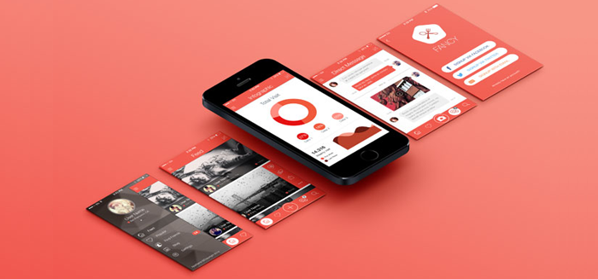
Advantages of setting up an app
Advantages of setting up an app
http://fpt.edu.vn

Slide 9
Steps to design app
• The primary responsibilities of UX professionals may include but are not limited to:
Performing user research;
Creating user personas;
Identifying the information architecture of an application;
Designing user flows and wireframes;
Creating prototypes;
Performing user testing.
http://fpt.edu.vn

Slide 10
A typical set of tasks for UI designers can include
Transforming requirements into style guides and attractive interfaces;
Identifying design problems and finding effective solutions;
Creating animations;
Choosing fonts and color palettes;
Designing UI elements like scrollbars and icons.
http://fpt.edu.vn

Slide 11
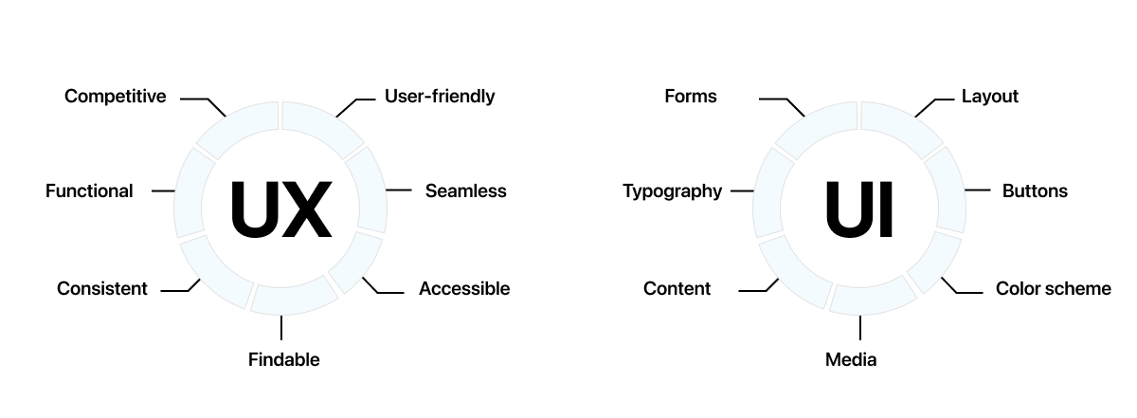
As you can see, UI and UX are the two sides of the same coin, as both lead to a better product experience. Therefore, it is essential to pay due diligence to each during the design process.
http://fpt.edu.vn

Slide 12
Lesson02
Introduction to UX Research

Slide 13
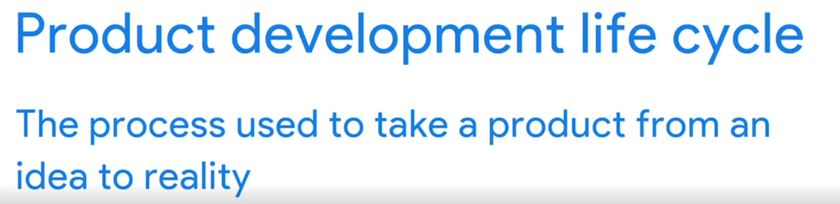
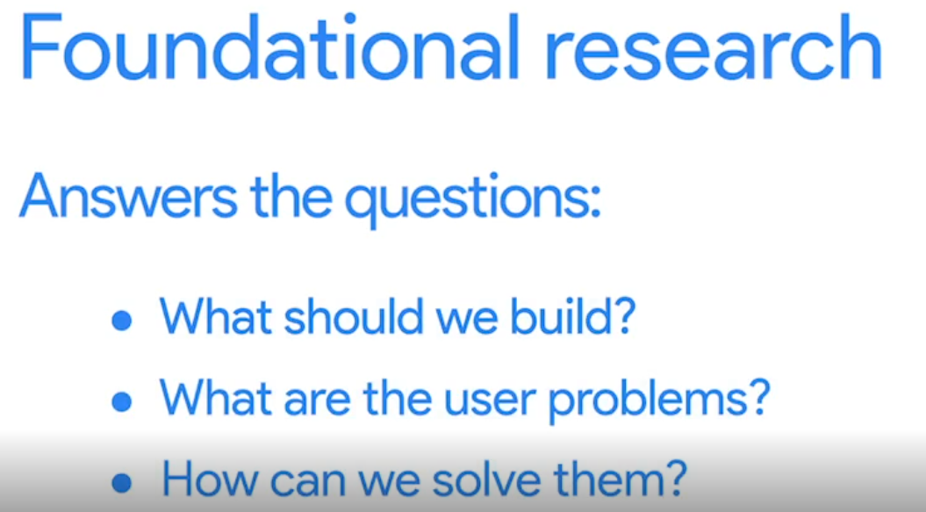
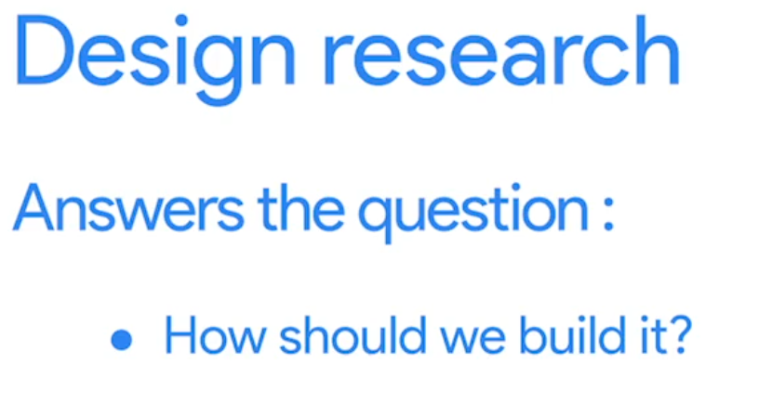
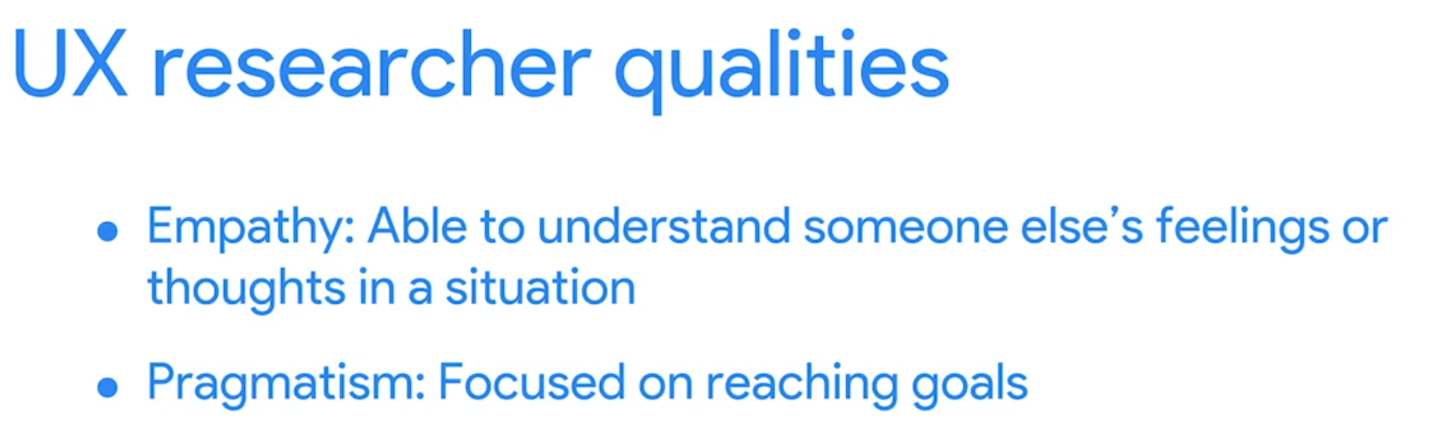
What is UX Research
UX research focuses on understanding user behaviors, needs, and motivations through observation and feedback.
The aim is to ensure that user priorities are balanced with business needs, helping to bridge the gap between what a business thinks the user needs and what the user actually needs before developing an expensive product.
During the design phase, research focuses on refining how the product should be built, often involving prototype testing to gauge user interaction and identify pain points. This is crucial for iterating on the design based on real user feedback.
http://fpt.edu.vn

Slide 14
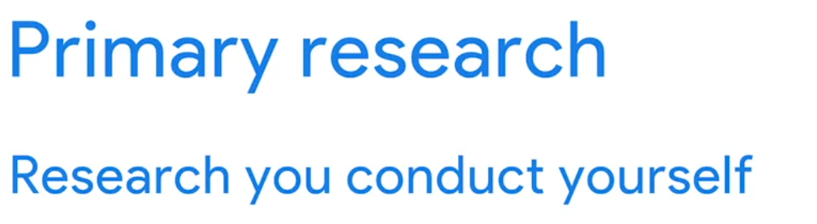
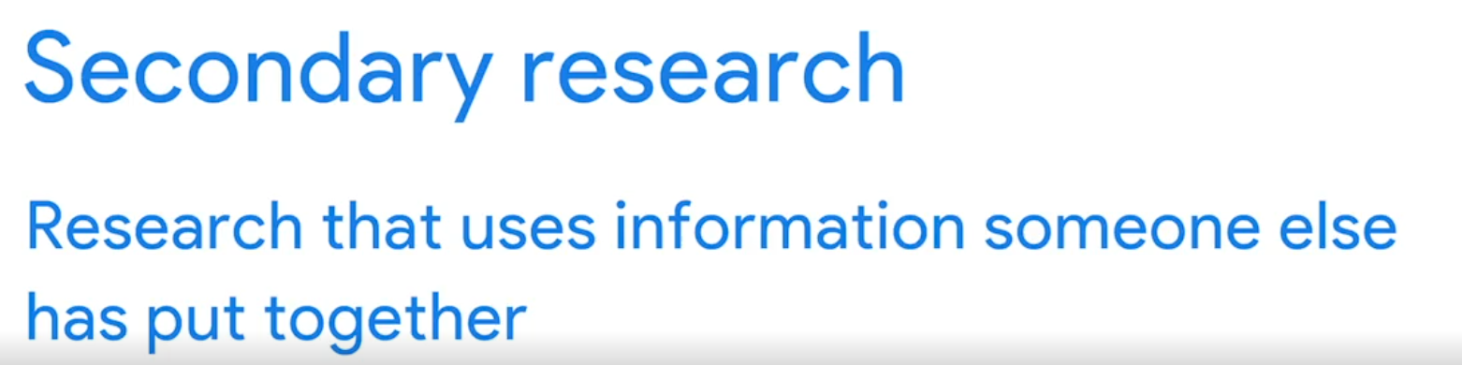

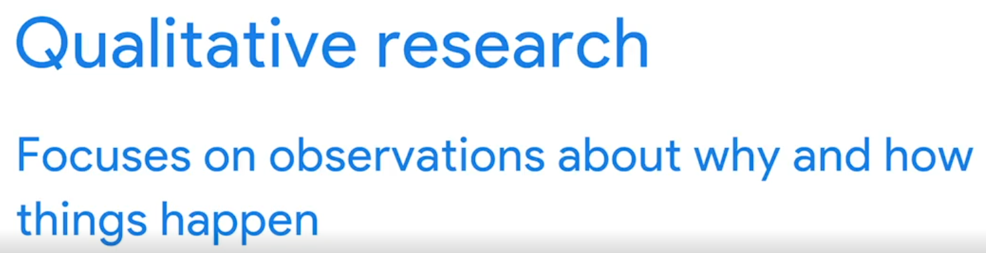
Choose the right method
Research methods are categorized based on two criteria: who conducts the research and the type of data collected. Here's a breakdown of each category:
Who Conducts the Research:
  Primary Research: Conducted firsthand by you. This includes activities like user interviews, surveys, or usability studies aimed at gathering direct feedback from users.
  Secondary Research: Involves compiling and analyzing information gathered by others. Sources may include books, articles, or previous studies, typically utilized at the beginning of the product development lifecycle.
Type of Data Collected:
  Quantitative Research: Focuses on numerical data that can be measured and quantified. It answers questions such as "How many?" or "How much?" This method is ideal for understanding broad user behaviors across large groups.
  Qualitative Research: Concentrates on observational data to provide deeper insights into user behaviors and motivations. It addresses questions like "Why?" or "How did this happen?"
Understanding these fundamentals aids in selecting the appropriate research method for your specific needs, with quantitative research providing the "what" and qualitative research offering the "why."
http://fpt.edu.vn

Slide 15
Drawbacks
Here's a summarized bullet point overview of the common user research methods and their benefits and drawbacks:
Secondary Research:
  Benefits:
    Accesses existing data on statistics, facts, and figures.
    Saves time and resources by leveraging already completed studies.
    Easily accessible with an internet connection.
    Can corroborate findings from primary research.
  Drawbacks:
    Does not provide insights into users' interactions with the product.
    Lacks direct feedback on users' reactions and experiences.
Interviews:
  Benefits:
    Offers deep insights into users' thoughts and motivations.
    Allows for follow-up questions to thoroughly understand user experiences.
  Drawbacks:
    Time-consuming and expensive, limiting the number of participants.
    Results in a smaller sample size, which may not represent the broader user base.
http://fpt.edu.vn

Slide 16
Drawbacks
Usability Studies:
  Benefits:
    Allows direct observation of user interactions with the product.
    Provides detailed feedback on usability and user experience.
  Drawbacks:
    Focuses only on the usability aspect of the product.
    Expensive due to the logistics of conducting the study and compensating participants.
    The lab environment may not accurately reflect real-world usage.
These summaries help in understanding the appropriate contexts for each research method and their implications for UX research.
http://fpt.edu.vn

Slide 17
Introduction to design thinking

Slide 18
Introduction to design thinking
The benefits of applying Design Thinking
Why Is Design Thinking so Important?

Slide 19
1. What is Design Thinking?
Design thinking is a non-linear, iterative process that teams use to understand users, challenge assumptions, redefine problems and create innovative solutions to prototype and test.
Involving five phases—Empathize, Define, Ideate, Prototype and Test—it is most useful to tackle problems that are ill-defined or unknown.
http://fpt.edu.vn

Slide 20
What Are the Four Principles of Design Thinking?
There are four principles of design thinking, written by Christoph Meinel and Larry Leifer of Stanford University’s Hasso-Plattner Institute of Design:
1. The human rule: This rule is based on the idea that a human-centric perspective will always solve technical problems in ways that will satisfy human needs.
http://fpt.edu.vn

Slide 21
2. The ambiguity rule: Designers have to think outside the box and give up the need to control a problem altogether. That will allow them to think and experiment more freely and have the creative confidence to consider fresh new solutions.
3. The re-design rule: Designers must look to the past to see how technology has previously addressed human needs. By understanding these methods, they can then look at ways to meet human needs in the future.
http://fpt.edu.vn

Slide 22
4. The tangibility rule: The newest of the four rules at the time of the principles’ publication, the tangibility rule suggests that prototyping is the best way to gain insight into how a new product can meet human needs by inspiring experimentation, discussion, and creative criticism.
http://fpt.edu.vn

Slide 23
The Five Stages of Design Thinking
The Hasso Plattner Institute of Design at Stanford (aka the d.school) describes design thinking as a five-stage process. Note: These stages are not always sequential, and teams often run them in parallel, out of order and repeat them in an iterative fashion.
http://fpt.edu.vn

Slide 24
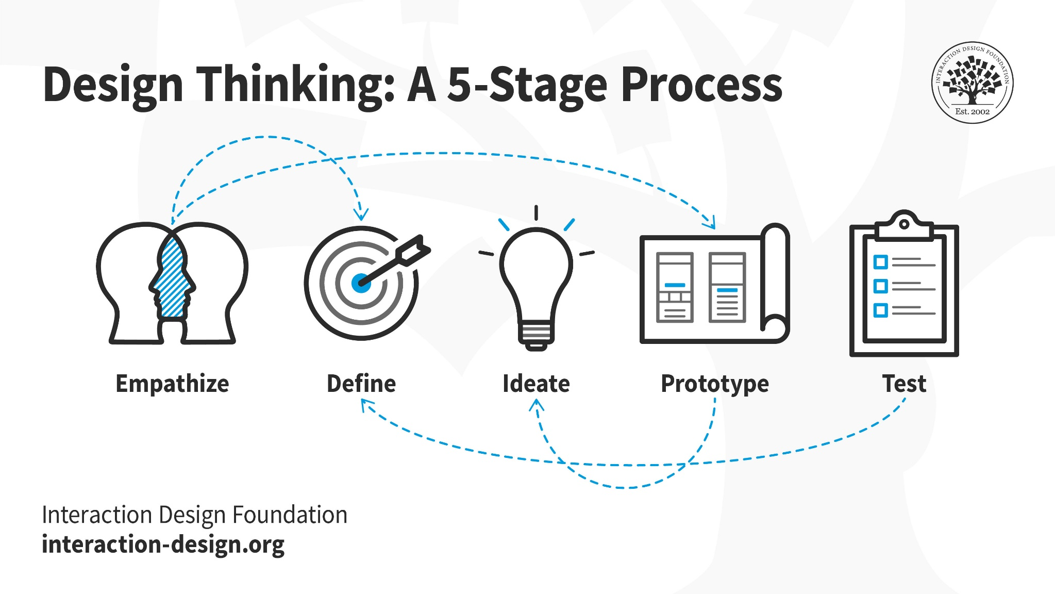
The Five Stages of Design Thinking
http://fpt.edu.vn

Slide 25
Stage 1: Empathize—Research Your Users' Needs
Here, you should gain an empathetic understanding of the problem you’re trying to solve, typically through user research. Empathy is crucial to a human-centered design process such as design thinking because it allows you to set aside your own assumptions about the world and gain real insight into users and their needs.
http://fpt.edu.vn

Slide 26
Stage 2: Define—State Your Users' Needs and Problems
It’s time to accumulate the information gathered during the Empathize stage. You then analyze your observations and synthesize them to define the core problems you and your team have identified. These definitions are called problem statements. You can create personas to help keep your efforts human-centered before proceeding to ideation.
http://fpt.edu.vn

Slide 27
Stage 3: Ideate—Challenge Assumptions and Create Ideas
Now, you’re ready to generate ideas. The solid background of knowledge from the first two phases means you can start to “think outside the box”, look for alternative ways to view the problem and identify innovative solutions to the problem statement you’ve created. Brainstorming is particularly useful here..
http://fpt.edu.vn

Slide 28
Stage 4: Prototype—Start to Create Solutions
This is an experimental phase. The aim is to identify the best possible solution for each problem found. Your team should produce some inexpensive, scaled-down versions of the product (or specific features found within the product) to investigate the ideas you’ve generated. This could involve simply paper prototyping
http://fpt.edu.vn

Slide 29
Stage 5: Test—Try Your Solutions Out
Evaluators rigorously test the prototypes. Although this is the final phase, design thinking is iterative: Teams often use the results to redefine one or more further problems. So, you can return to previous stages to make further iterations, alterations and refinements – to find or rule out alternative solutions.
http://fpt.edu.vn

Slide 30
Stage 1: Empathize—Research Your Users' Needs
Empathy with User

Slide 31
Empathize
Define
Ideate
Prototype
Test

Slide 32
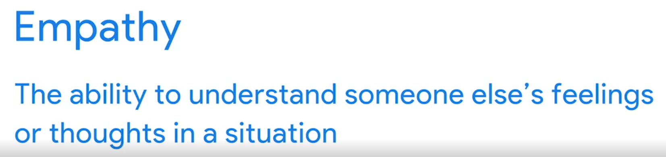
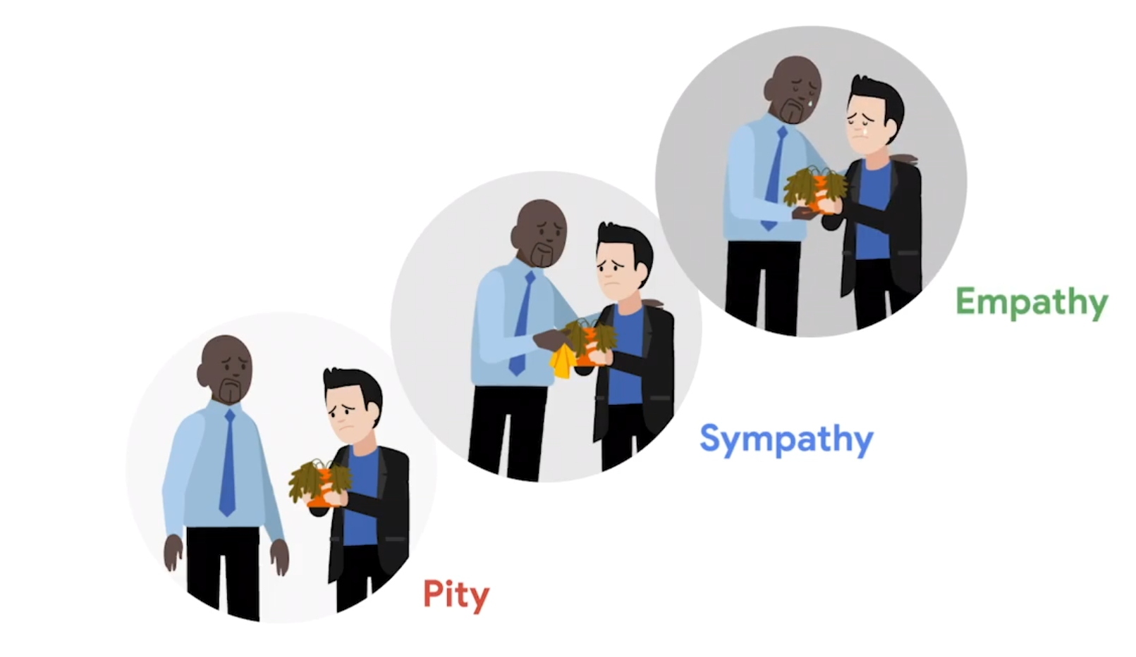
1. Empathize
Empathy in UX Design:
  Empathy is the ability to understand and share the feelings or thoughts of someone else within their context.
  It's vital in every step of the design thinking process, enabling designers to address the actual needs of users rather than assumptions.
Understanding Empathy vs. Similar Concepts:
  Pity involves feeling sorry for someone but often carries condescending overtones.
  Sympathy means acknowledging someone's feelings without experiencing them yourself.
  Empathy, however, involves truly sharing someone’s emotional and mental experiences, making it deeper and more connected than sympathy or pity.
http://fpt.edu.vn

Slide 33
1. Empathize
The Role of Empathy in UX Research:
  Approaching UX research with empathy allows designers to solve the right problems, focusing on what users genuinely need rather than what we assume they need.
  It helps prevent misconceptions about users by grounding design decisions in real user feedback and insights.
The Importance of Correcting Assumptions:
  Like meeting a new person, initial assumptions about users can often be incorrect.
  UX research helps uncover the true needs and desires of users, correcting any misjudgments and allowing designers to develop more effective and empathetic solutions.
Empathy is at the core of UX design, making it crucial for designers to engage deeply with user research to truly understand and address the needs of the people they are designing for.
http://fpt.edu.vn

Slide 34
1. Empathize
During the empathize phase, you’ll spend time observing and engaging with real users (or people who represent your target group)—conducting interviews, seeing how they interact with an existing product, and generally paying attention to facial expressions and body language.
As the first step in the Design Thinking process, the empathize phase encourages you to set your assumptions aside. Armed with first-hand insights, you’ll be able to design with real users in mind. That’s what Design Thinking is all about!
http://fpt.edu.vn

Slide 35
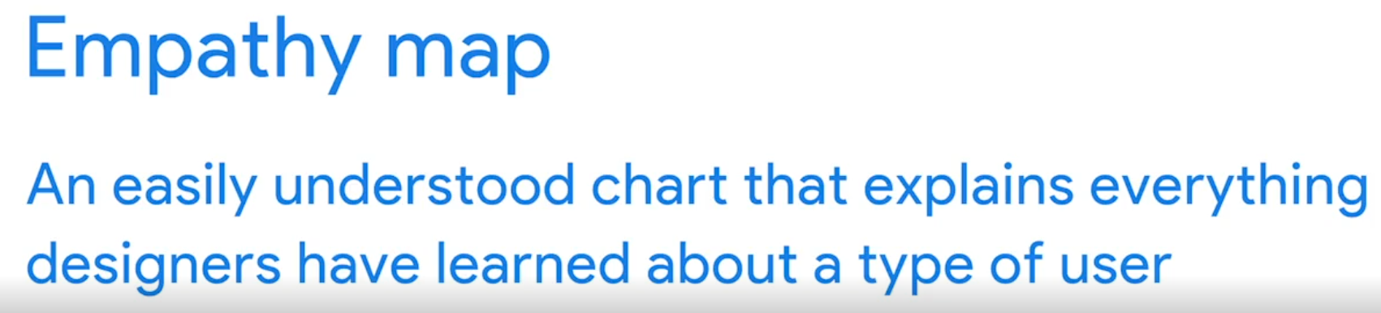
Build empathy map
This tool is a straightforward visual representation that encapsulates everything designers have learned about a user. It helps in visualizing empathy and is fundamental in understanding our users deeply.
What is an Empathy Map?
  An empathy map is structured with four quadrants that represent what the user says, does, thinks, and feels.
  The center of the map highlights the 'user', where these insights converge.
http://fpt.edu.vn

Slide 36
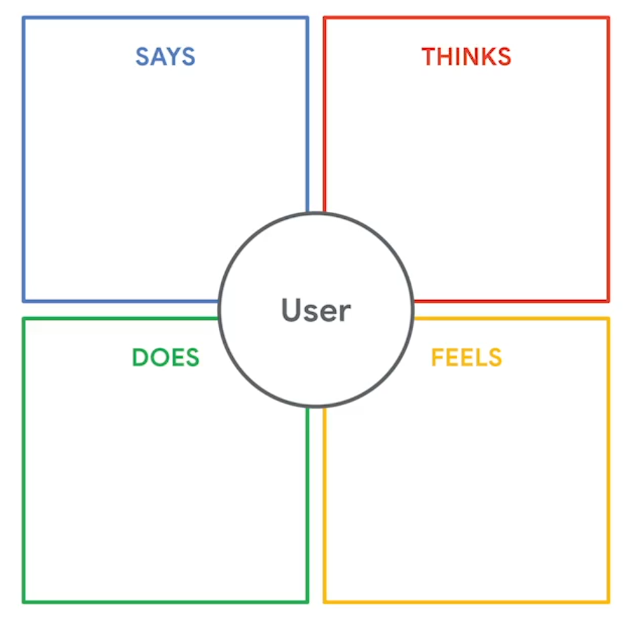
Build empathy map
How to Fill Out an Empathy Map:
  Top Left (Says): Direct quotes from the user during interviews or feedback sessions.
    Example: Simone, a user testing a food delivery app, might say, "I wish food delivery apps provided more accurate time estimates."
  Bottom Left (Does): Observable actions the user takes during interaction with the product.
    Example: Simone refreshes the app page multiple times and reads the contents carefully.
  Top Right (Thinks): Insights into the user’s thoughts, which are inferred rather than explicitly stated.
    Example: Simone’s furrowed brow might suggest she’s thinking, "This is really annoying."
  Bottom Right (Feels): Emotional responses of the user during the interaction, which can be asked directly in an open-ended manner.
    Example: Asking Simone, "How did you feel when trying to place an order?" might reveal her frustrations or satisfaction.
http://fpt.edu.vn

Slide 37
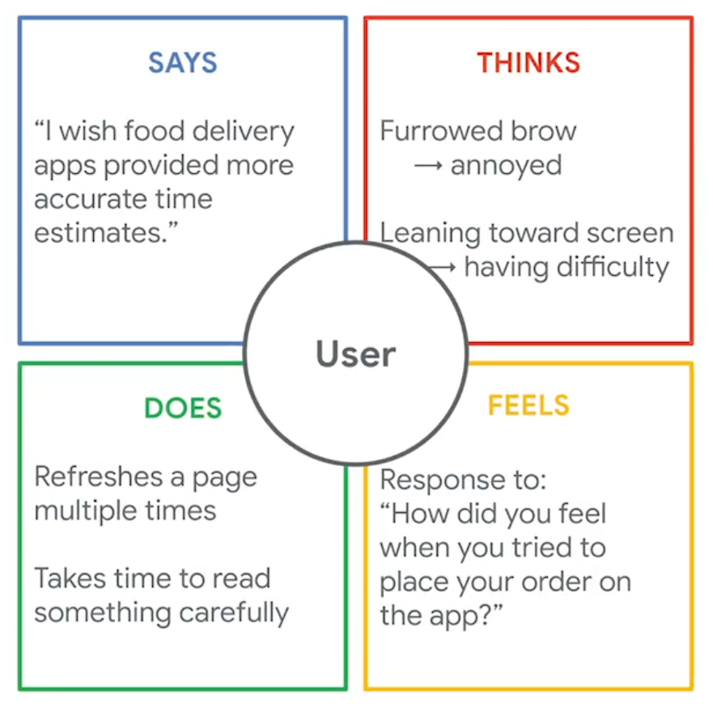
Build empathy map
Suppose you are part of a team developing a food delivery app that promises deliveries in 30 minutes or less.
By interviewing users like Simone and observing their interactions with the app prototype, you gather valuable data to fill each quadrant of the empathy map.
http://fpt.edu.vn

Slide 38
2. Where does empathy fit into the Design Thinking process?
We know that empathy is crucial—so where does it fit into the Design Thinking process?
Empathy is considered the starting point for any design project, and constitutes phase one of the Design Thinking process. During the empathise phase, the designer spends time getting to know the user and understanding their needs, wants, and objectives. This means observing and engaging with people in order to understand them on a psychological and emotional level.
http://fpt.edu.vn

Slide 39

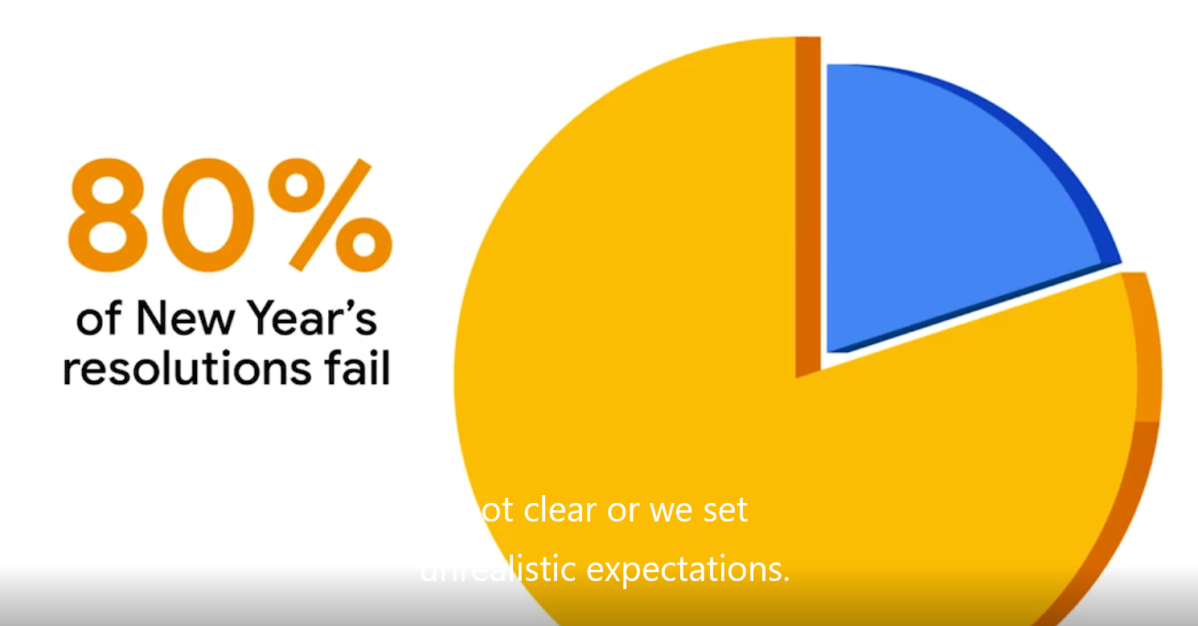
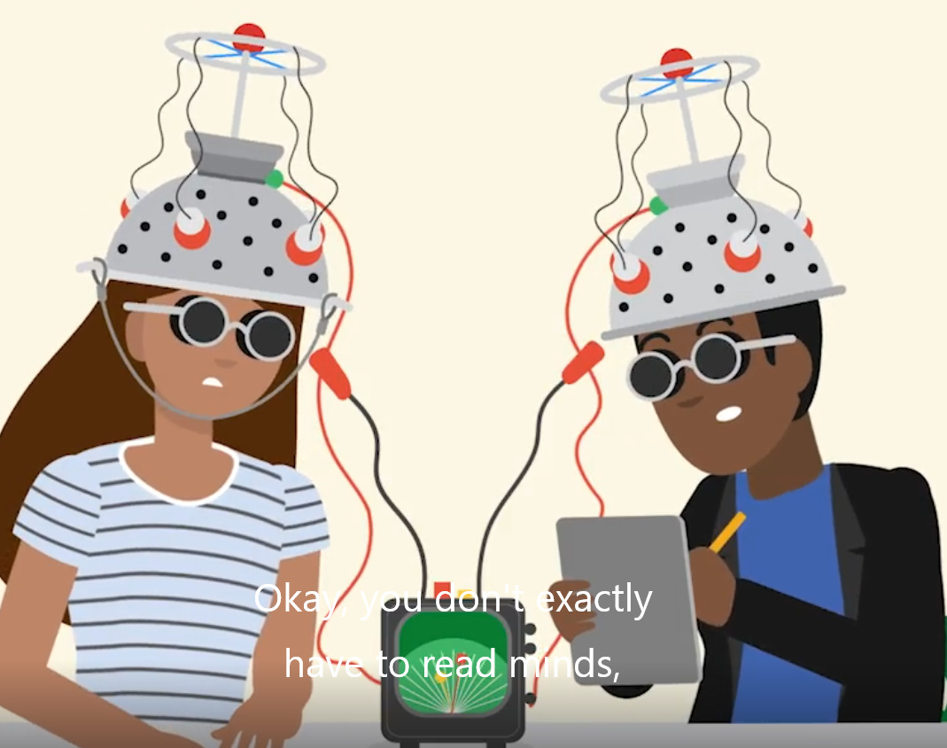
Identify pain points
Core Role of UX Designers:
  UX designers are fundamentally problem-solvers, focusing on identifying and resolving user struggles or pain points.
  Pain points are any UX issues that frustrate users and prevent them from achieving their goals.
Examples of User Pain Points:
  A classic example is the Norman Door, where a door that looks like it should pull but needs to be pushed causes user frustration.
  Difficulty in finding customer service information on a website, requiring extensive navigation, is another common user pain point.
http://fpt.edu.vn

Slide 40
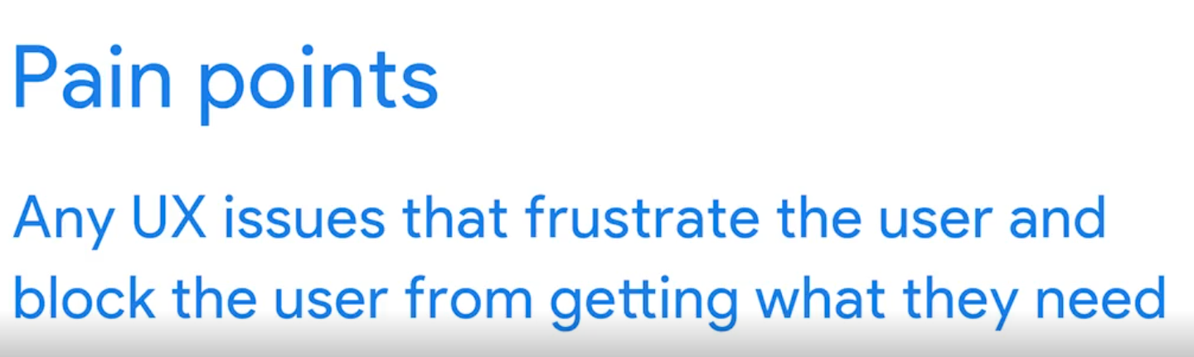
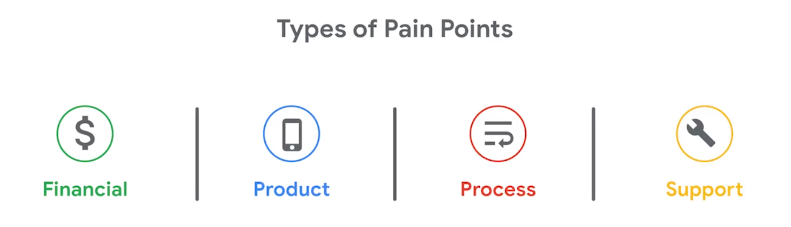
Identify pain points
Categories of Pain Points:
  Financial Pain Points: These involve monetary concerns, such as encountering unexpected paywalls.
  Product Pain Points: Related to product quality issues, such as ineffective product designs like the Norman Door.
  Process Pain Points: Frustrations encountered in the steps required to complete an action, like complicated online checkout processes.
  Support Pain Points: Occur when users need help but find it difficult to obtain, such as hard-to-find support information.
http://fpt.edu.vn

Slide 41
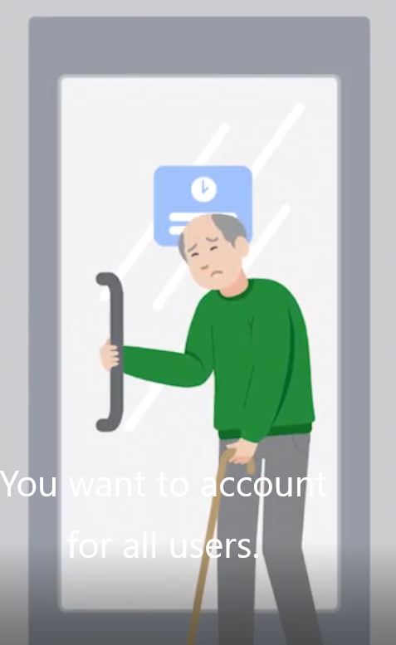
Identify pain points
Empathy and Design:
  Designers need to empathize deeply with users, understanding not just what they express, but also anticipating needs they may not be aware of.
  Considerations for diverse user abilities, such as accommodating users in wheelchairs, are crucial in designing accessible products.
Tools for Understanding Users:
  Empathy Maps: These tools help designers understand what users think, say, do, and feel, providing insights into user experiences and pain points.
  Empathy maps are stepping stones to creating detailed user personas, which represent typical users and their needs, helping designers maintain focus on user-centered design throughout the product development process.
Understanding and addressing these pain points effectively requires a blend of empathy and analytical skills, ensuring that solutions are both intuitive and tailored to meet users' real-world needs.
http://fpt.edu.vn

Slide 42
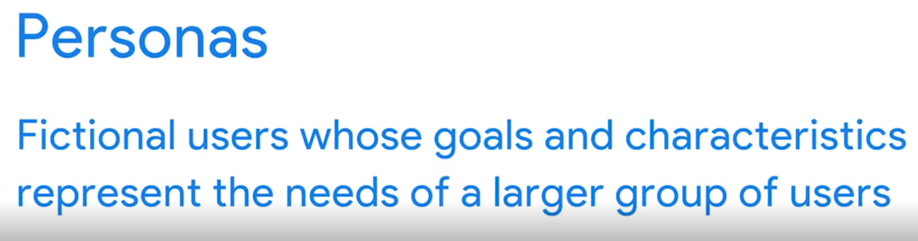
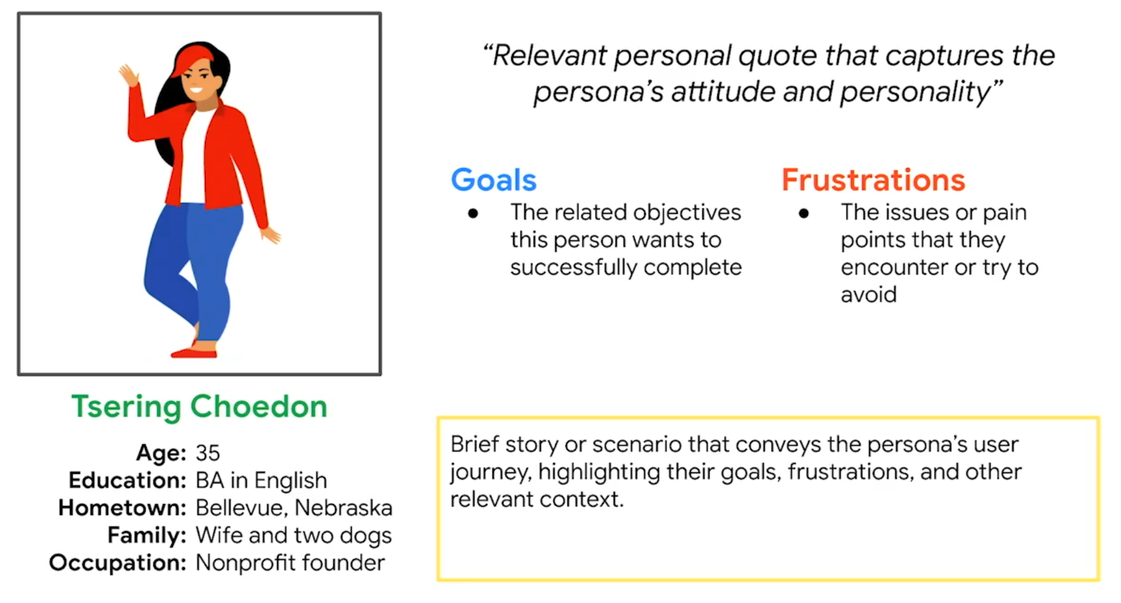
Understand Personas
Understanding Personas:
  In UX design, personas are fictional characters created based on user research. These characters embody the goals, needs, and observed behavior patterns of larger user groups, helping designers focus on a targeted audience.
The Role of Personas:
  Personas help identify common patterns of behavior among users, which can point to widespread pain points that need addressing.
Creation of Personas:
  Unlike pure fictional characters, personas are built on solid research. This ensures they accurately represent real potential users. They're not conjured from thin air but are instead informed by interviews, surveys, and other forms of user interaction.
http://fpt.edu.vn

Slide 43
Understand Personas
Practical Application:
  Imagine designing a fundraising app for connecting nonprofits with volunteers. Through research, you might find distinct patterns in how different demographics engage with such platforms—like rural versus urban professionals—and use this data to create nuanced personas.
Developing a Persona:
  For instance, you might develop a persona named Tsering Choedon, a 35-year-old nonprofit founder from Bellevue, Nebraska. Tsering represents rural nonprofit owners interested in environmental causes and is characterized by specific professional and personal details that help make her relatable and realistic to your design team.
http://fpt.edu.vn

Slide 44
Understand Personas
Using Personas in Design:
  Personas enable designers to visualize the needs and experiences of their users, helping tailor design solutions to meet these needs effectively. They ensure the design process remains user-centered by continuously reminding the team of who they are designing for.
Building Comprehensive Personas:
  It's crucial to develop a diverse set of personas to cover the range of your user base adequately. Each persona should reflect different segments of your target audience, ensuring that various user needs, preferences, and behaviors are considered in the design process.
The Value of Personas:
  Beyond helping target user needs, personas humanize the design process, facilitate empathy, and make user needs more tangible and understandable for everyone involved in the project. They also provide a narrative that can engage stakeholders and help them understand the importance of design decisions.
http://fpt.edu.vn

Slide 45
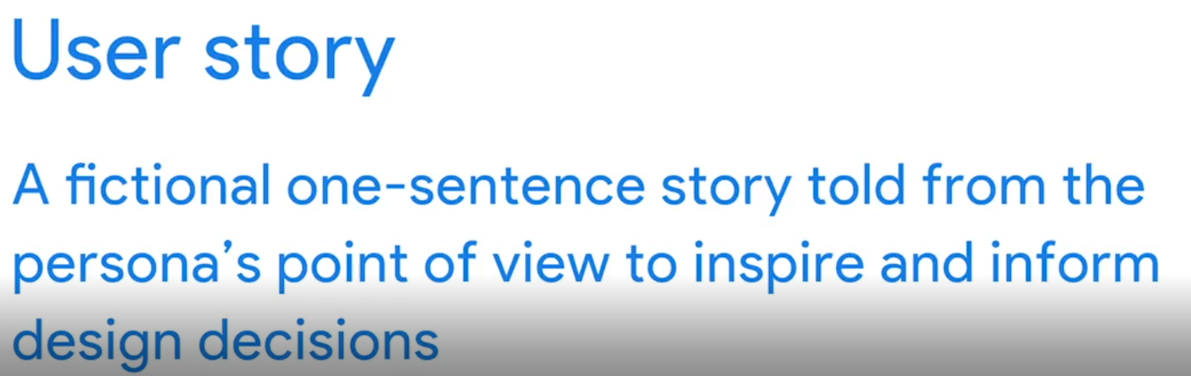
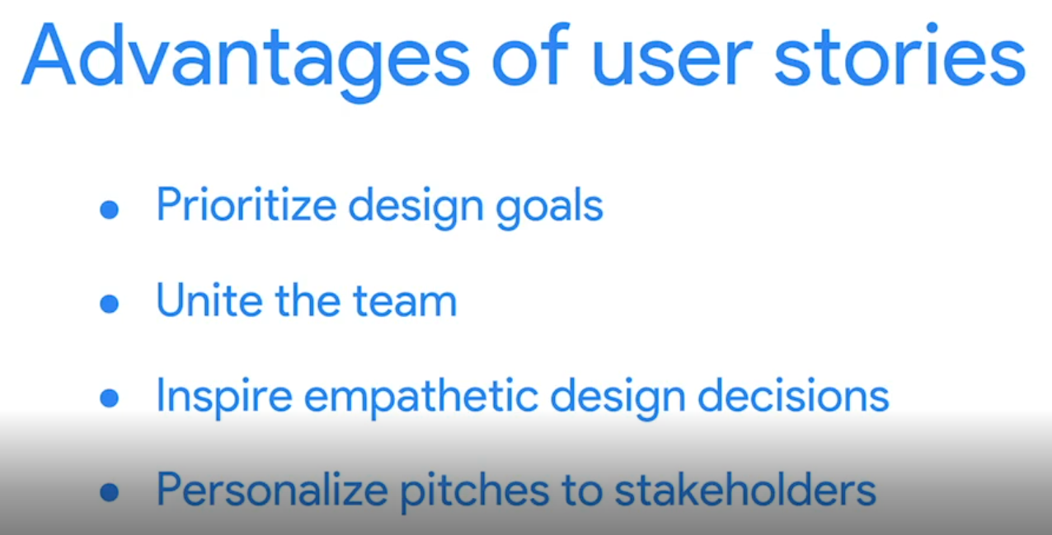
User Story
User stories prioritize design goals: user stories determine which ones are the most critical to resolve.
User stories also unite the team around a clear goal. A good user story can also inspire empathetic design decisions by making our approach user-centered, also known as user-centric.
And finally, user stories personalize pitches to stakeholders. You aren't just presenting your design update ideas. You're demonstrating how the updates will help specific types of people.
http://fpt.edu.vn

Slide 46

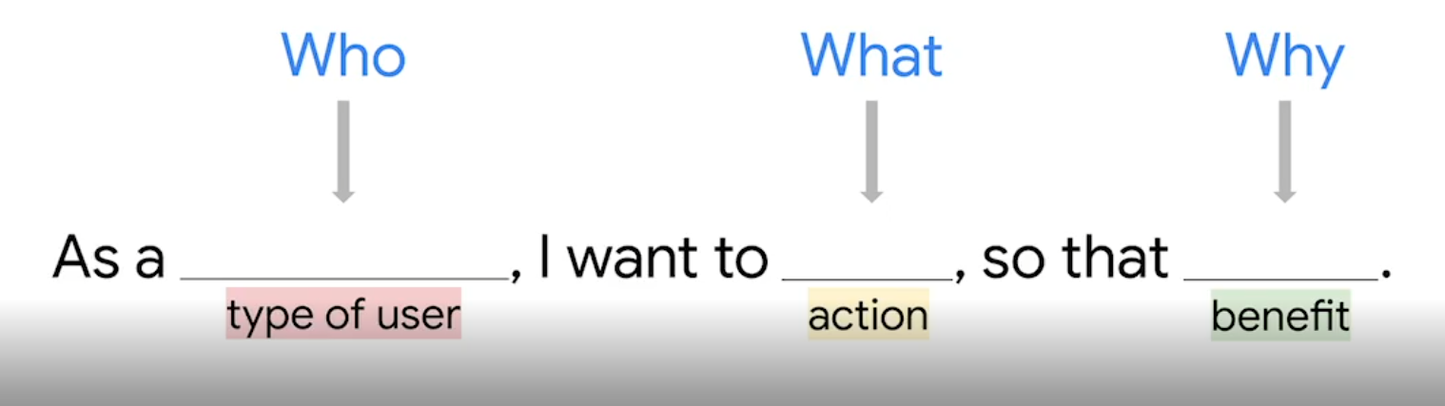
How do you write a user story
Like a classic short story, user stories have a hero with an ultimate goal and a conflict that keeps them from conquering that goal. To write a user story, we follow this simple formula: As a type of user, I want to action, so that benefit.
All that's left now is filling in the missing pieces.
Type of user describes who we are designing for.
Action is what the user hopes will happen.
And finally, benefit is why the user wants the action to happen.
This formula keeps the problem user-centered, actionable, and clear. Let's think about a user story that I experience all the time: As an online shopper, I want to receive a text when the item arrives so that I can pick it up right away.
As an online shopper, I want to receive a text when the item arrives so that I can pick it up right away.
http://fpt.edu.vn

Slide 47
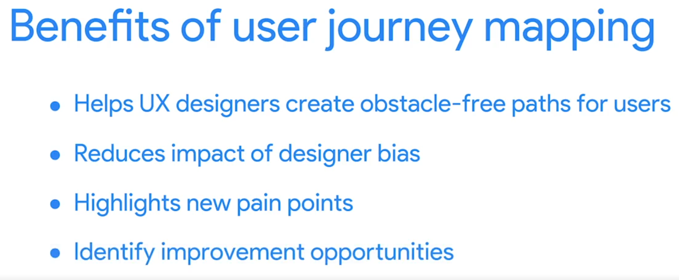
Create User Journey Map
Introduction to User Journeys: User journeys describe the sequence of experiences a user undergoes while interacting with a product.
These journeys are built on previously established personas and user stories, enhancing the designer’s ability to empathize with the user and ensure the design genuinely assists them.
Detailed Mapping Process: Exploring the journey map starts by identifying key tasks the user must complete.
http://fpt.edu.vn

Slide 48
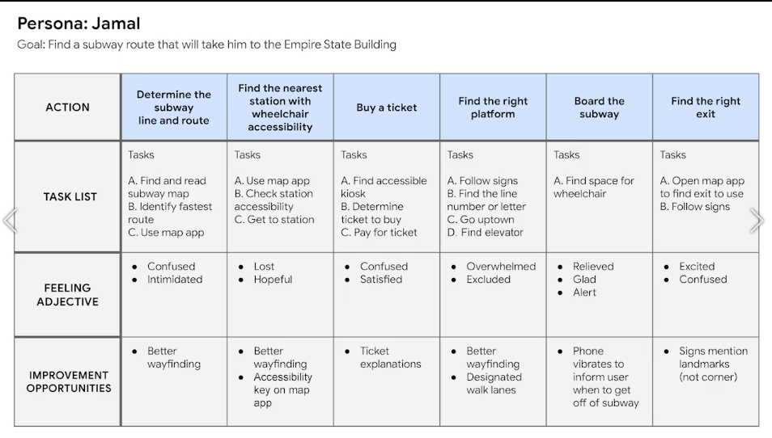
Create User Journey Map
http://fpt.edu.vn

Slide 49
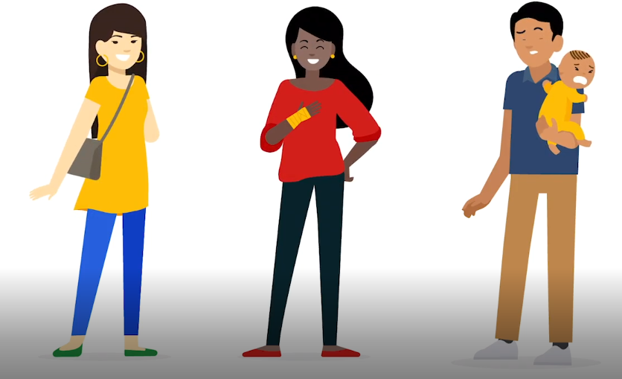
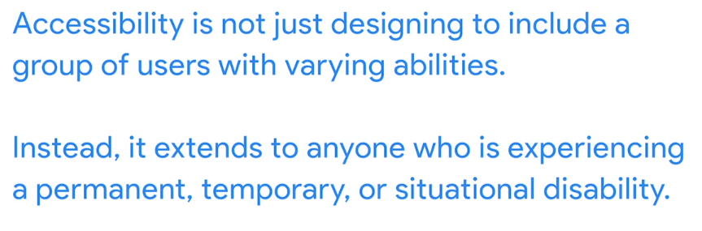
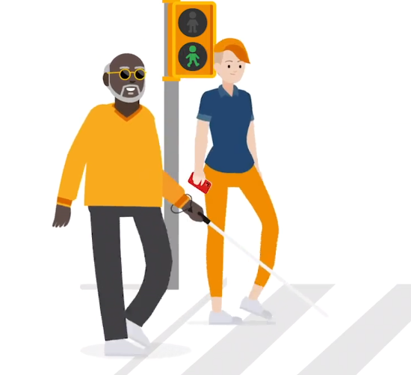
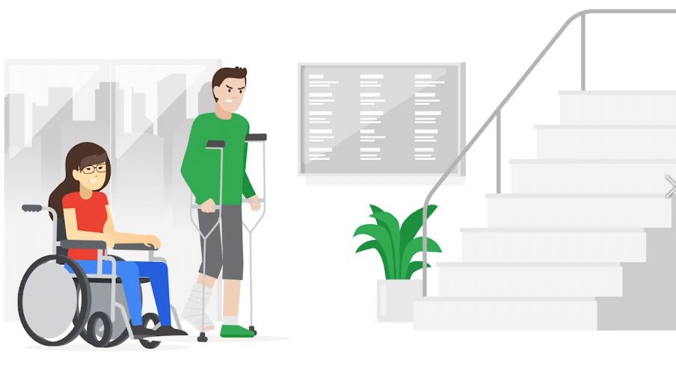

Consider Accessibility
http://fpt.edu.vn

